Slide 1
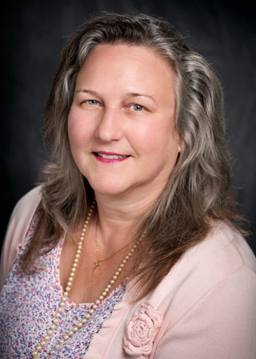
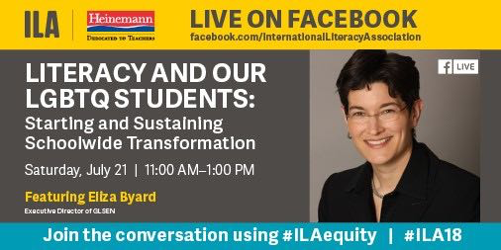
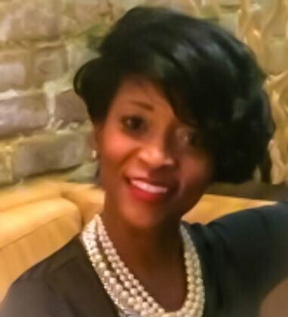
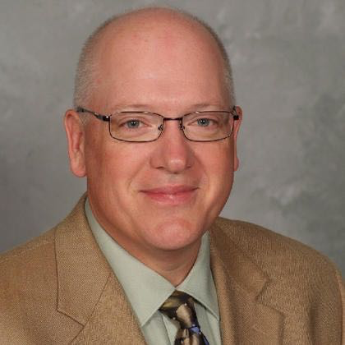
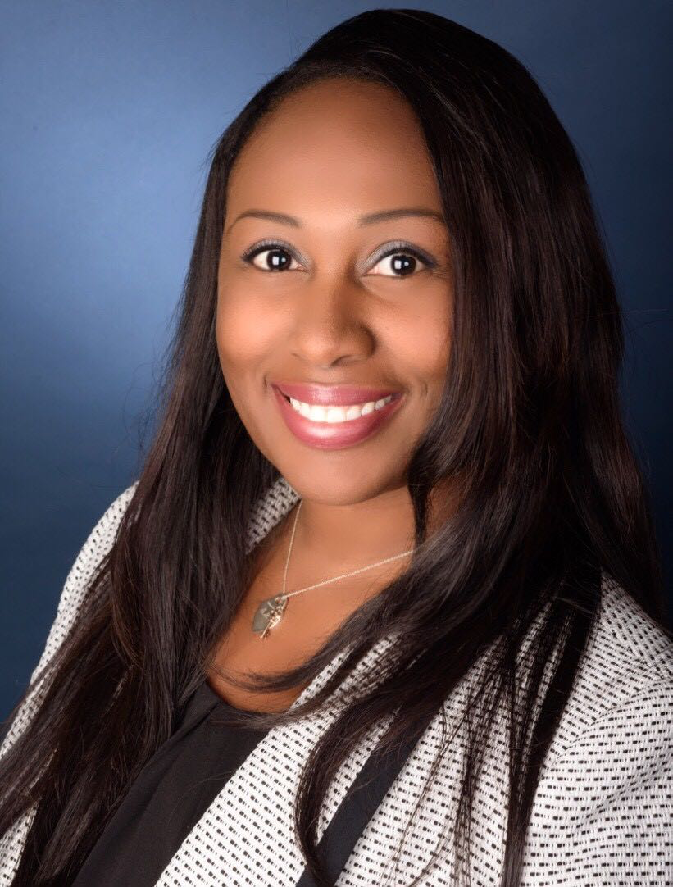
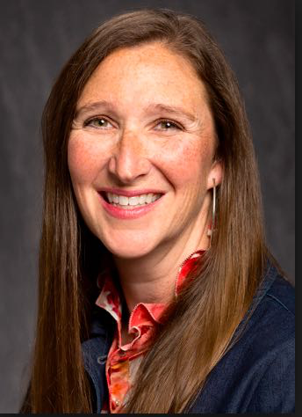
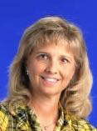
Conversations from the Field on the
Impact of Literacy Leadership:
Cultivating Effectual Writing Teachers
and Building Teacher Writing Capacity
July 21, 2018 / 1:00 PM - 2:00 PM
Austin Convention Center/ Theater 18D
1:00 PM - 2:00 PM
Margaret-Mary Sulentic Dowell, PhD
Nakia Jackson, Ed.S., - Principal
Audubon Elementary Baton Rouge, LA
Jason Lau, Principal
Westwood Elem School- De Pere, WI
Earlisha J. Whitfield, Ed.S.-Assistant Principal
Iberville Charter Academy, Plaquemine LA
Alicia Bennett, NBCT, 1st Grade Instructor
The Dunham School, Baton Rouge, LA
Ellen Daughtery, NBCT- Literacy Coach
University Lab School, LSU, Baton Rouge , LA

